Slide 1





Theme: Social Cause
UniSafe
CREATING A SAFE AND INCLUSIVE ENVIRONMENT
TEAM NAME: DBDT
TEAM MEMBERS: Nakul (Leader)
Aditya Kumar Singh
PAGE 01

Slide 2


Introduction
UniSafe is a web-based emergency alert system designed for instant campus safety. With a one-tap SOS alert, students can notify security in critical situations like harassment, medical emergencies, or fire hazards. It features real-time GPS tracking, direct communication, and multimedia evidence capture, ensuring a fast and reliable emergency response for a safer campus.
Why we choose this theme & topic?
Campus safety demands speed and efficiency. Delayed responses can risk lives in emergencies like harassment or medical crises. UniSafe bridges the gap with instant alerts, real-time tracking, and direct communication, ensuring help is just one tap away
01
What problem are you solving?
02
+20K
Universities lack a fast and reliable emergency response system, leading to delayed action in critical situations like harassment, medical emergencies, and fire hazards. Traditional reporting methods are slow, making it difficult for security teams to locate and assist students in real time. UniSafe solves this by providing instant alerts, live GPS tracking, and direct communication, ensuring a quick and effective response when it matters most.
03
04
PAGE 02

Slide 3
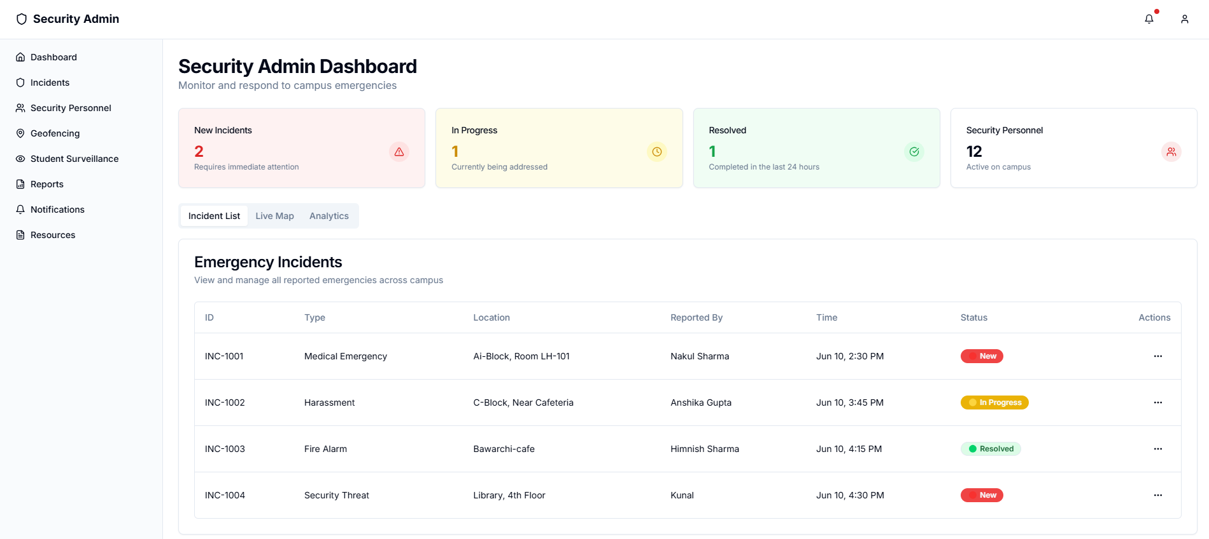
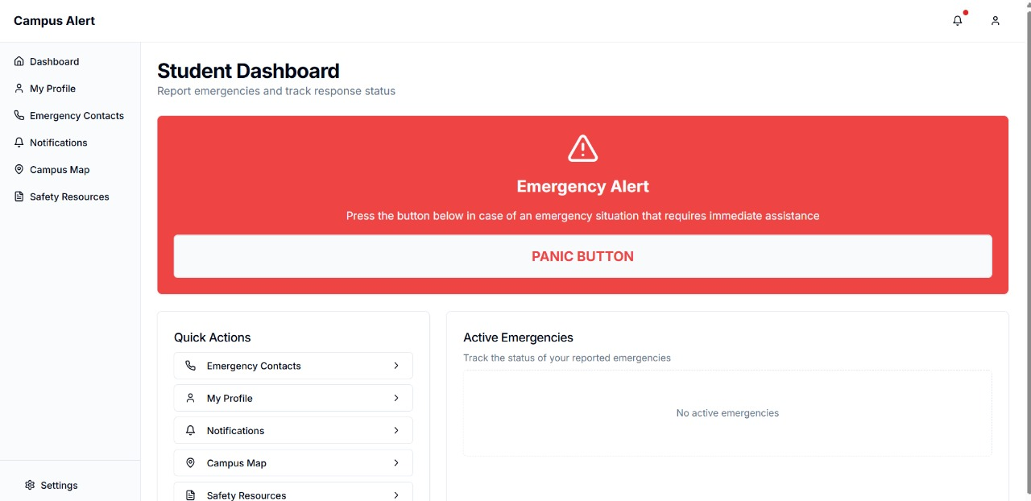
Two Powerful Portals for Campus Safety
ROOT CAUSES
Admin Portal
The Admin Portal equips security teams with a live dashboard to monitor emergencies in real time. It enables incident assignment, tracking, and AI-driven risk analysis to detect high-risk areas. Security personnel can directly communicate with students, ensuring swift action, better coordination, and a safer campus environment.
Student Portal
UniSafe’s Student Portal empowers students to report emergencies instantly with a one-tap SOS alert. It shares real-time location, allows photo, video, and audio uploads for evidence, and enables direct chat or calls with security. Students can also track their incident status, ensuring they stay informed and receive timely assistance.
RISK FACTORS
PAGE 03

Slide 4
Expected Outcome
The final Campus Emergency Alert System will be a responsive and intuitive web app designed for real-time emergency reporting and security response. It will feature a one-tap SOS Panic Button, instant location-based alerts, and a dashboard for security teams to track and manage incidents efficiently. With live mapping, status updates, and emergency contact notifications, the system ensures quick response and enhanced campus safety while maintaining a modern, user-friendly interface
PAGE 04

Slide 5
Timeline & Responsibilities
Roles: Nakul (Backend Development)
Aditya (Frontend Development)
Milestones
Planning & Research
Development Phase
Testing & Deployment
Finalized problem statement & project idea. (Completed)
Frontend UI implementation (Completed)
Deployment and final presentation.(Completed)
PAGE 05

